Slide 1
The vanishing Generation: Us Birth rate Plunge

Slide 2
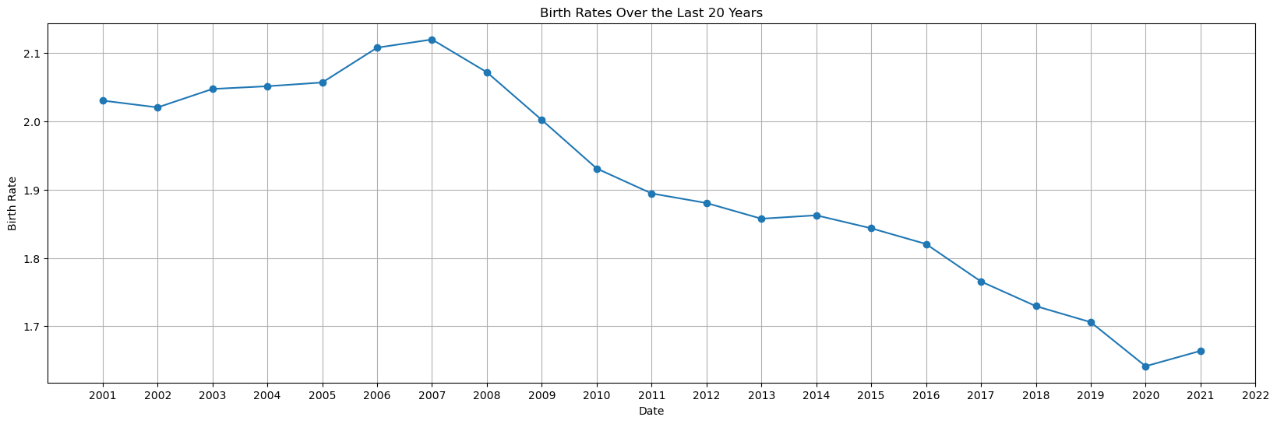
Trending in Birth Rate
Declining Birth Rates: The United States has been experiencing a significant decline in birth rates over the last twenty years.
﻿﻿Factors at Play: Multiple factors contribute to this trend, such as delayed marriage, economic challenges, and lifestyle choices.
﻿﻿Impact on Population: The declining birth rate poses potential consequences for the population's age structure and future economic growth.
﻿﻿CDC data provides valuable insights into this pressing issue.

Slide 3
Factors Influencing Decline
Changing Attitudes: Cultural shift towards delayed marriages and smaller families.
﻿﻿Economic Pressures: Rising cost of living and financial constraints impacting family planning.
﻿﻿Education and Career: Focus on higher education and career advancements leading to delayed parenthood.
﻿﻿Access to Contraception: Widespread availability and use of effective birth control

Slide 4
Demographic Shifts
Declining Birth Rate: The birth rate in the United States has been steadily declining over the past few decades.
﻿﻿Implications for Society: A declining birth rate
can lead to an aging population and potential strain on social security and healthcare systems. Value of Parenthood: Changing social norms and economic factors are influencing people's decisions to have fewer children.

Slide 5
Economic Impact
Declining Birth Rates: Fewer babies being born in the United States.
﻿﻿Labor Force: Decreasing number of young workers entering the workforce. Dependency Ratio: Higher ratio of older adults to working-age population. Social Security: Challenges in sustaining the retirement system with fewer contributors.

Slide 6
Changing Family Dynamics
Declining Birth Rate: The birth rate in the United States has been steadily decreasing over the years.
﻿﻿Factors at Play: Several factors contribute to the declining birth rate, such as delayed marriage and career advancement.
﻿﻿Shift in Priorities: Many couples are choosing to focus on personal fulfillment rather than starting a family early.
﻿﻿Societal Impact: The declining birth rate impacts the economy, healthcare, and social welfare programs.

Slide 7
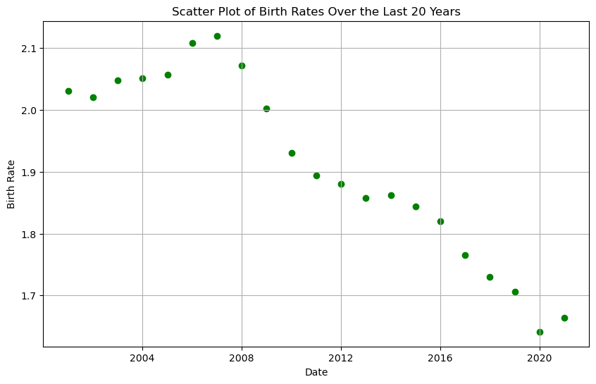
Long-Term Consequences
Declining Birth Rate: The birth rate in the United States has been steadily declining over the past few decades.
﻿﻿Impact on Society: A declining birth rate can have significant implications for the future of our society.
﻿﻿Aging Population: As the birth rate declines, the population gets older, leading to increased healthcare and pension costs.

Slide 8
Conclusion
Declining Birth Rate: The United States is experiencing a significant decline in its birth rate.
Impact on Population: The declining birth rate will have long-term consequences on the country's population growth and demographic composition.
﻿﻿Reasons for Decline: Multiple factors, including changing societal norms and economic challenges, contribute to the declining birth rate.

